Slide 1
Computational Thinking?
Session-3

Slide 2
Table of Contents
Algorithm
Pseudocode
Flowchart

Slide 3

Flowcharts
Let’s discuss and try to predict what does flowchart mean!
Notes:
8 min at the end no debrief

Slide 4
Flowcharts
A flowchart is a diagram that represents
a sequence of instructions.
Flowcharts have standard symbols
to represent different instructions.

Slide 5
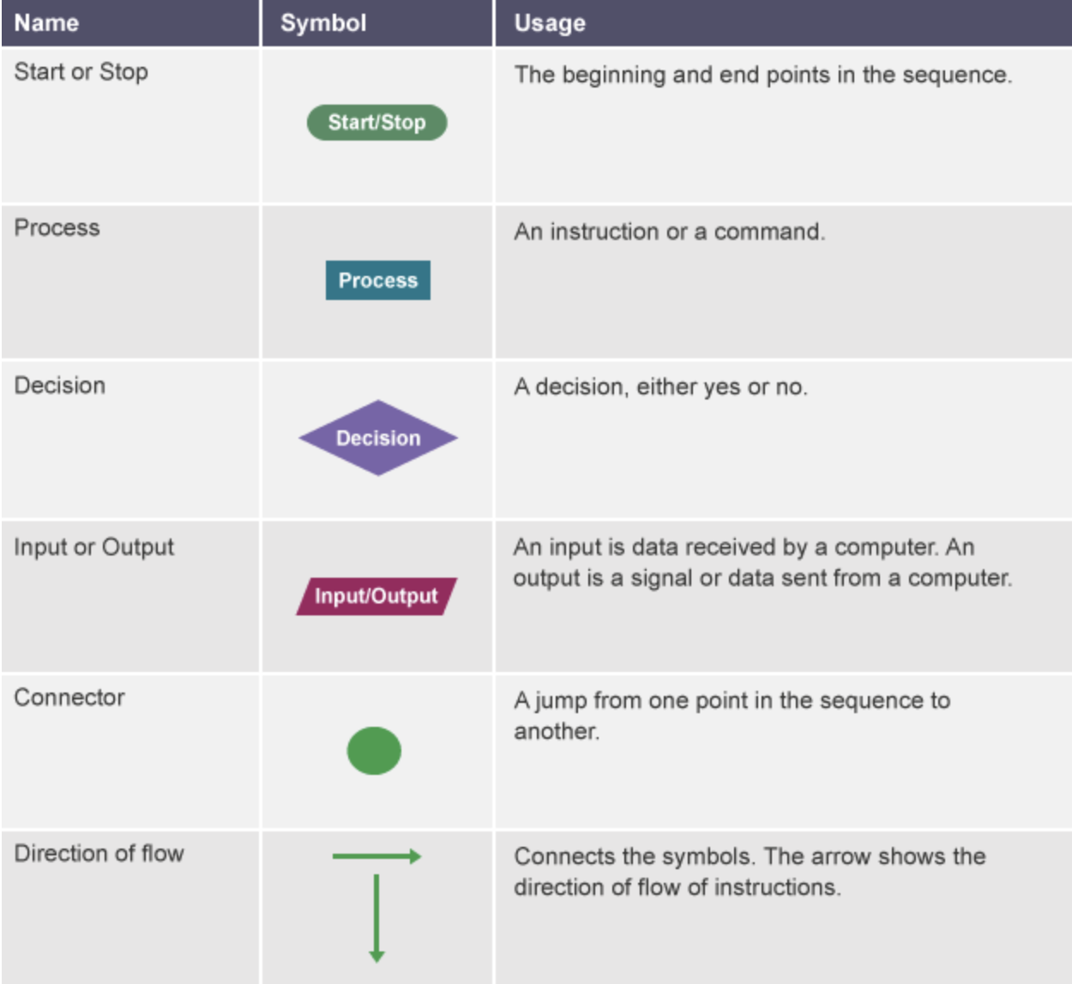
Flowcharts

Slide 6
Example
START
INPUT number1 ,number2 sum=number1+number2
PRINT sum
END
Do you remember? Let's draw the flowchart.
Notes:
🍐 This is a Pear Deck Text Slide
🍐 To edit the type of question, go back to the "Ask Students a Question" in the Pear Deck sidebar.

Slide 7
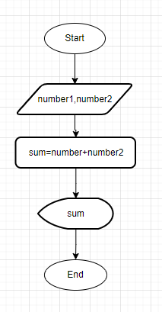
Example
START
INPUT number1 ,number2 sum=number1+number2
PRINT sum
END
Notes:
🍐 This is a Pear Deck Text Slide
🍐 To edit the type of question, go back to the "Ask Students a Question" in the Pear Deck sidebar.

Slide 8
Example
Takes a number and show is the number odd or even?
START
Input number
r=number mod 2
IF r==0
print ‘even’
ELSE
print ‘odd’
END
Notes:
🍐 This is a Pear Deck Text Slide
🍐 To edit the type of question, go back to the "Ask Students a Question" in the Pear Deck sidebar.

Slide 9
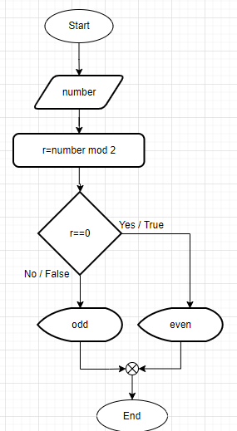
Example
Takes a number and show is the number odd or even?
START
Input number
r=number mod 2
IF r==0
print ‘even’
ELSE
print ‘odd’
END
Notes:
🍐 This is a Pear Deck Text Slide
🍐 To edit the type of question, go back to the "Ask Students a Question" in the Pear Deck sidebar.

Slide 10
Example
START
INPUT a,b,c
big=a
IF b>big
big=b
IF c>big
big=c
print big
END
Do you remember? Let's draw the flowchart.

Slide 11
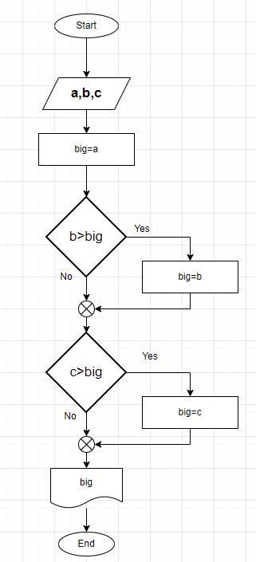
Example
START
INPUT a,b,c
big=a
IF b>big
big=b
IF c>big
big=c
print big
END

Slide 12
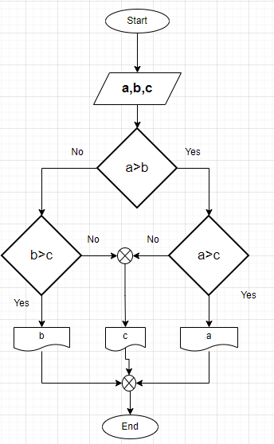
Example
Another solution

Slide 13
Assignment
Calculate the shipping fee according to the information given in the table
distince | price multiplier by distance
0-500 | 50
500-1000 | 100
1000+ | 500

Slide 14
Assignment solution
distince | price multiplier by distance
0-500 | 50
500-1000 | 100
1000+ | 500
START
packagetPrice, packageWeight, distance
INPUT " Enter Package Weight ", packageWeight
INPUT " Enter Distance ", distance
IF (distance >= 0) and (distance <= 500)
packagetPrice = packageWeight * 50
ELSE IF (distance > 500) and (distance <= 1000)
packagetPrice = packageWeight * 100
ELSE
packagetPrice = packageWeight * 500
PRINT "Package Price=" + packagetPrice
END

Slide 15
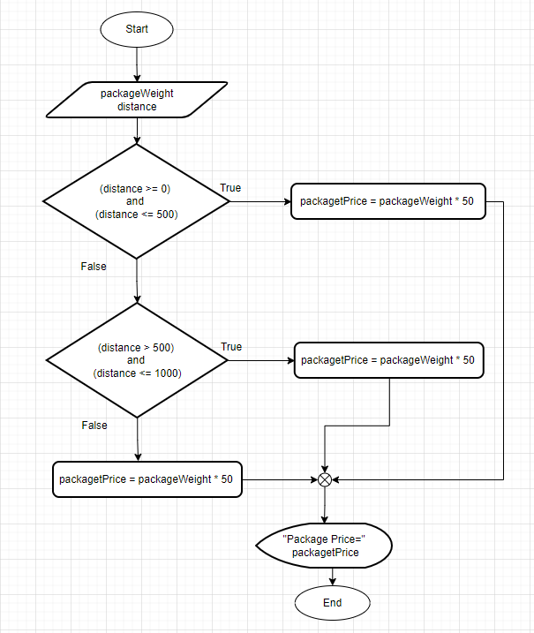
Assignment solution
distince | price multiplier by distance
0-500 | 50
500-1000 | 100
1000+ | 500
START
packagetPrice, packageWeight, distance
INPUT " Enter Package Weight ", packageWeight
INPUT " Enter Distance ", distance
IF (distance >= 0) and (distance <= 500)
packagetPrice = packageWeight * 50
ELSE IF (distance > 500) and (distance <= 1000)
packagetPrice = packageWeight * 100
ELSE
packagetPrice = packageWeight * 500
PRINT "Package Price=" + packagetPrice
END

Slide 16
Example
START
IF lamp plugged in
IF bulp burned out
repair lamp
GoTo end
ELSE
Plug in lamp
GoTo end
ELSE
plug in lamp
go to end
END

Slide 17
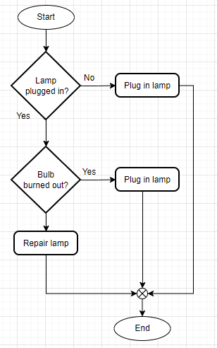
Example
START
IF lamp plugged in
IF bulp burned out
repair lamp
GoTo end
ELSE
Plug in lamp
GoTo end
ELSE
plug in lamp
go to end
END

Slide 18
Login Diagram Draw a flowchart to login to your facebook account
Notes:
Access Prior Knowledge
Use the template to prompt students to access prior knowledge on today’s topic. You can change the wording to fit your lesson.
🍐 This is a Pear Deck Drawing Slide
🍐 To edit the type of question, go back to the "Ask Students a Question" in the Pear Deck sidebar.

Slide 19
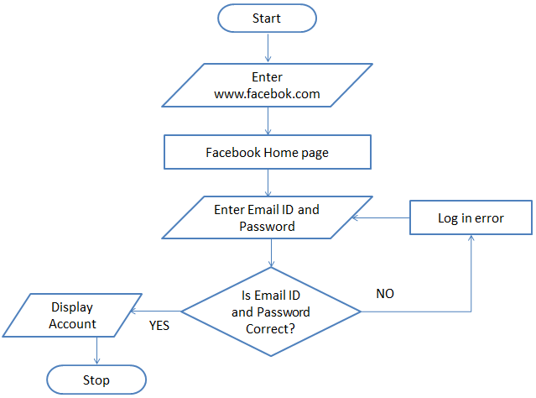
Login Diagram
A flowchart to login to facebook account:

Slide 20
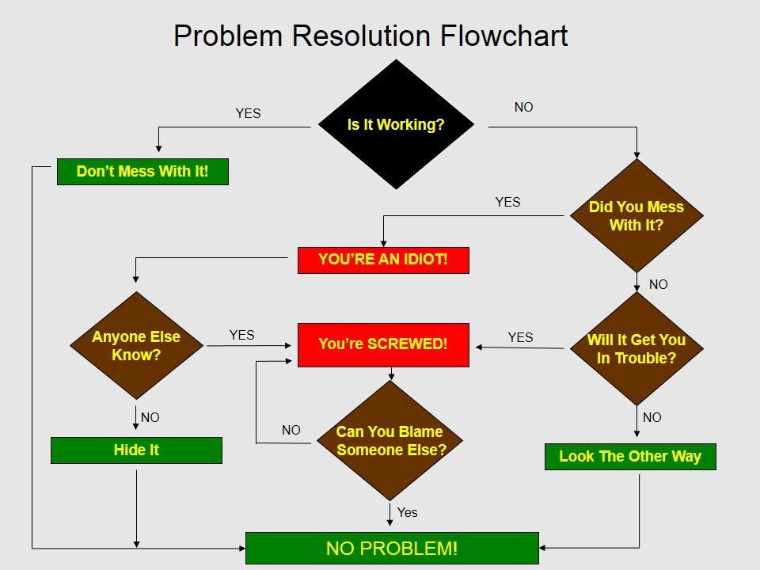
Flowcharts

Slide 21
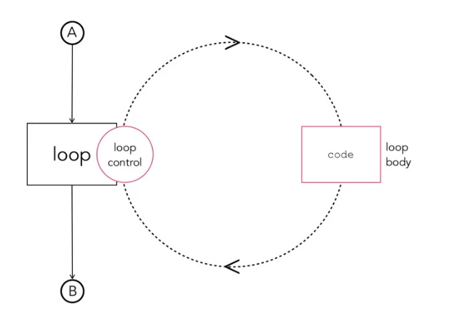
LOOPS
A loop is a sequence of instruction s that is continually repeated until a certain condition is reached.
Notes:
Those keywords might help you on every occasion.

Slide 22
FOR structure
For loop runs for each element inside a group.
For example:
FOR every day of the week
Count;
ENDFOR

Slide 23
FOR structure
For loop runs for each element inside a group. For example:
For every 25 minutes of study
Earn one Pomodoro;
endfor
Pomodoro = Pomodoro +1

Slide 24

Let’s wash the dishes
Let’s wash the dishes. Think that we have all the tools etc.

Slide 25
Let’s wash the dishes
gather the dirty dishes
if you have a dishwasher around you
put the dirty dishes inside the dishwasher
set the settings of the dishwasher
while the time set is not over
wait
else
while dishes are not clean
take one of the dishes
wash it with your hand
dry it and put it aside

Slide 26
WHILE Structure
While is similar to the for loop, differently it runs the loop until the condition provided is unsatisfied.
Example:
Apples = 5
Oranges = 10
While apples < oranges
increase apples;
endwhile

Slide 27
THANKS!
Any questions?

